Slide 1
A Journey of PROJECTS….

Slide 2
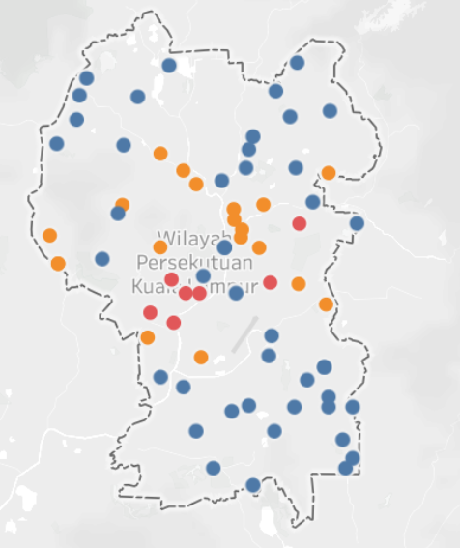
RECOMMENDATION SYSTEM FOR opening a new mall in Kuala lumpur, Singapore

Slide 3
Objective
To analyse and select the best locations in the city of Kuala lumpur,
Malaysia to open a new Mall.
Location of the mall is one of the most important decisions that will
determine whether the mall will be a success or failure.

Slide 4
Advantages
The main advantage is with out using human hard effort we are able
to classify where we want to start our Mall.

Slide 5
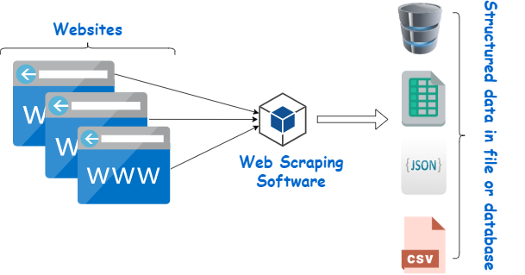


Dataset required
List of neighbourhoods in Kuala lumpur.
Latitude and Longitude coordinates of the neighbourhoods.
Venue data, particularly related to malls.

Slide 6



TOOLS AND TECHNOLOGIES

Slide 7
CHALLANGES FACED AND TIME TAKEN
The first challenge I faced when decided to do project on Recommendation System is I had no idea about where to find the dataset, So I took help from our faculty coordinator and he suggested about Web scrapping.
It took 10 days to complete the project.

Slide 8
Improvements in future and drawbacks
There are several other classification algorithms apart from clustering
which were better. So in future implementation I would like to
implement them.
The only drawback is we are using smaller dataset.

Slide 9
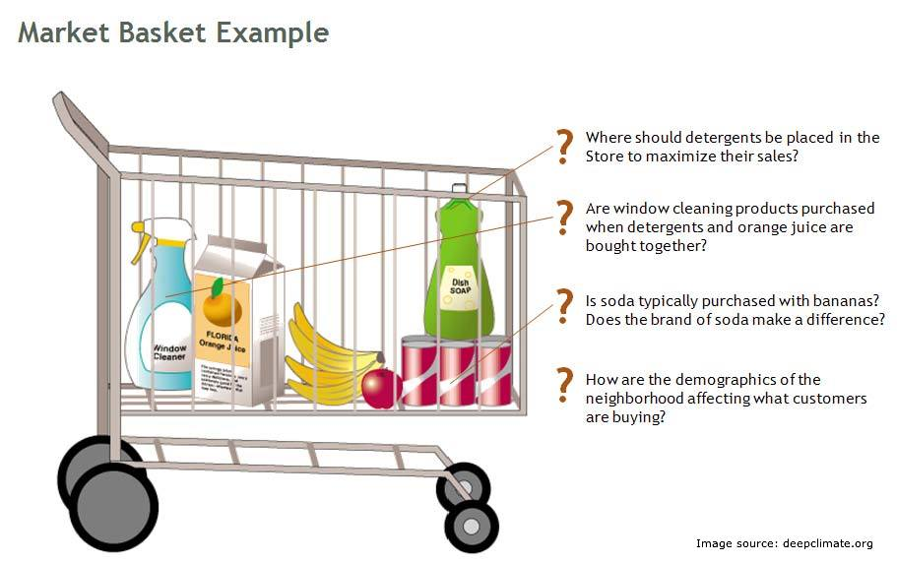
E-Commerce profitability and recommendation system for supermarket

Slide 10

Dataset
We had collected the dataset from Kaggle.com
Link - https://www.kaggle.com/c/instacart-market-basket-analysis/data

Slide 11
TOOLS AND TECHNOLOGIES

Slide 12
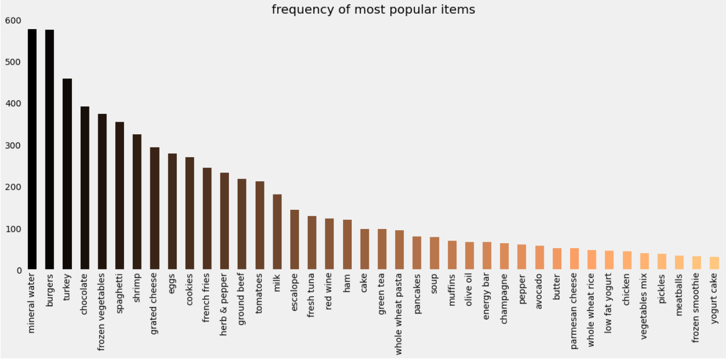
Advantages
With this project we can help Supermarkets in increasing their sales.
We can also identify frequently sold items and non frequently sold
items.

Slide 13
Personal contribution
We have done this project with a group of 2 people, we have divided
the work into 3 parts.
My friend had done pre-processing.
I have applied Apriori Algorithm and generated Association rules to
find frequently sold items.
Finally we both had done the remaining coding part and visualised
the outcome.

Slide 14
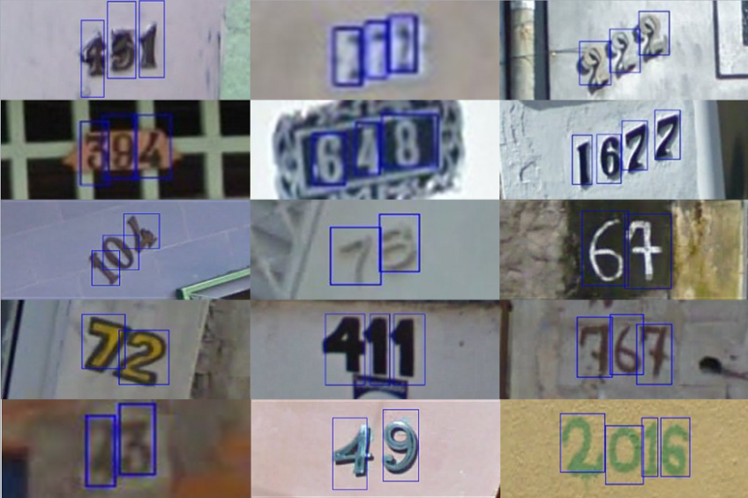
Optical character recognition

Slide 15
Objective
To extract text from possible images.

Slide 16
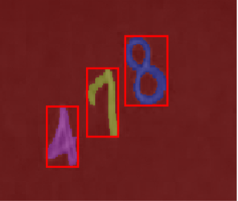
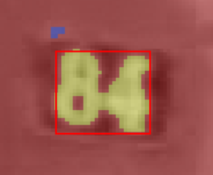
Dataset required
Used SVHN (Street View House Numbers) dataset.

Slide 17
TOOLS AND TECHNOLOGIES

Slide 18
Methodology
Applied filters to make the characters stand out from the
background.
Then contour detection to recognize the characters one by one.
And finally image classification to identify the characters.

Slide 19
Improvements in future and drawbacks
There are several other classification algorithms apart from clustering
which were better. So in future implementation I would like to
implement them.
The only drawback is we are using smaller dataset.

Slide 20
Libraries used
threshold_otsu (it calculate pixels)
clear_border ( to clear image borders)
bg_label (to make background transparent)
Label2rgb (covrerts label image to rgb)

Slide 21

PAYROLL Management System

Slide 22
INTRODUCTION
It is a software program that enables the business to handle all the employee’s records in a hassle free.
In this project we have created a payroll management system using concepts of Java.

Slide 23
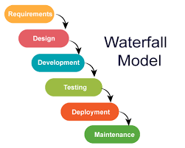
SDLC Used

Slide 24
ADVANTAGES
With out payroll it becomes very hard for an organisation to maintain its details of employees so in order to store the data of employers we have created a payroll management system.

Slide 25

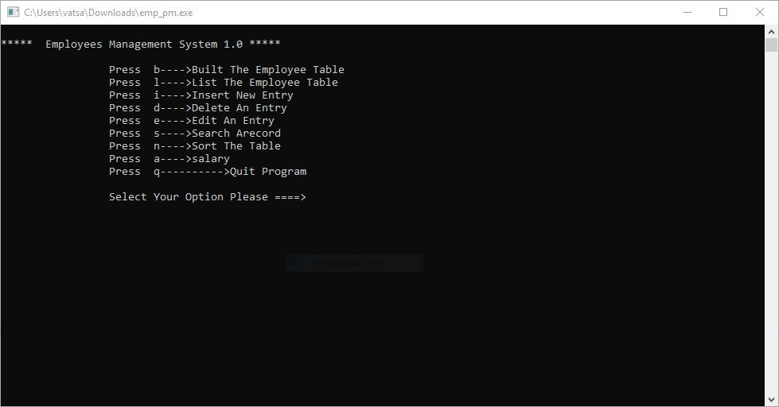
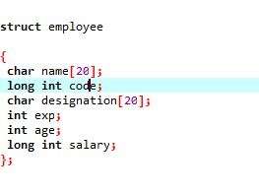
TOOL AND TECHNOLOGIES

Slide 26
Personal contribution and role in the project
We had done this as a group of 2 peoples project.
I have done the coding part.
My friend had gathered online resources required for the project and prepared documentation.

Slide 27
Challenges and time taken
Since it was our first project in the B.Tech we have faced a lot of
challenges while doing this project but we have overcome those odds
with the help of our faculty coordinators and hard work.
It took 10 days to complete the project.

Slide 28
Improvements needed and drawbacks
I Think there are no further improvements needed because we have checked all the edge cases in the project.
Sample cases are like:
1.Salary should always be >0
2.There should be no special characters in the names of employee.
The only draw back is UI part.

Slide 29
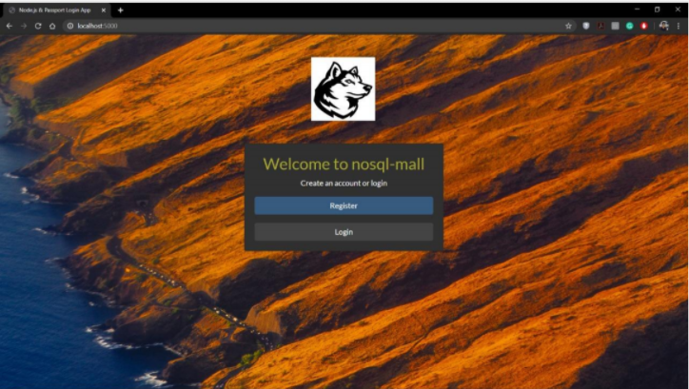
Web Based design and implementation of online store

Slide 30
Objective
To main objective is to develop a model of E-Commerce application
which focuses on a couple of key structures contained in typical
E-commerce systems.
In this project we included attributes like product categories, Prices,
Shopping carts.

Slide 31
Advantages
The main advantage is as we used MongoDB no need to create Tables
for each relation like in Relational Databases, just a single document
is enough.

Slide 32


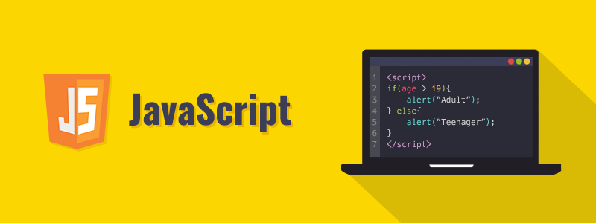
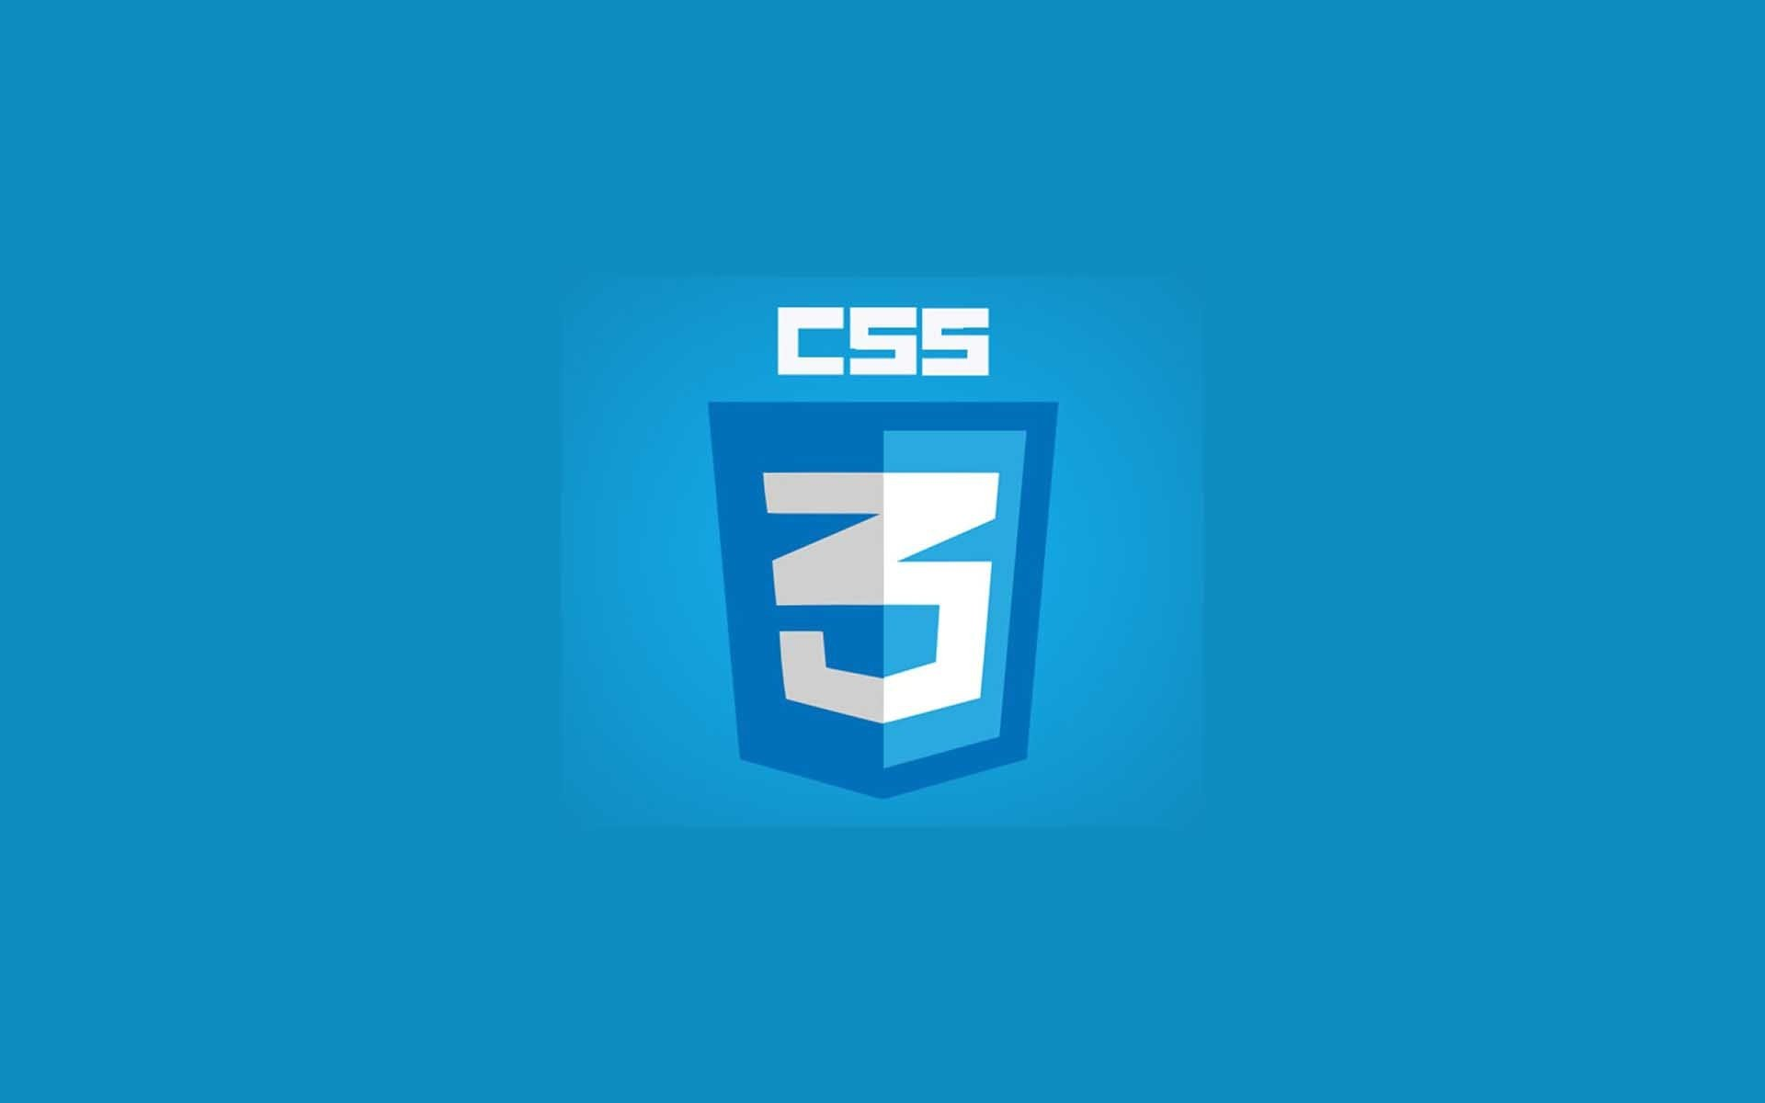
Tools and technologies

Slide 33
CHALLANGES FACED AND TIME TAKEN
The first challenge I faced when decided to do project on web development is I had no idea about html, CSS, JavaScript. So I took suggestions from my friend and started a course in COURSERA on web development and it has helped me in a great way.
It took 40 days to complete the project.

Slide 34
Personal contribution
We have done this project with a group of 2 people.
We divided the project into 4 modules.
Register and Login modules are done by myself.
Database and modules are done by other member in group.
Finally we both completed the documentation part.

Slide 35
Thank You….

